Slide 1
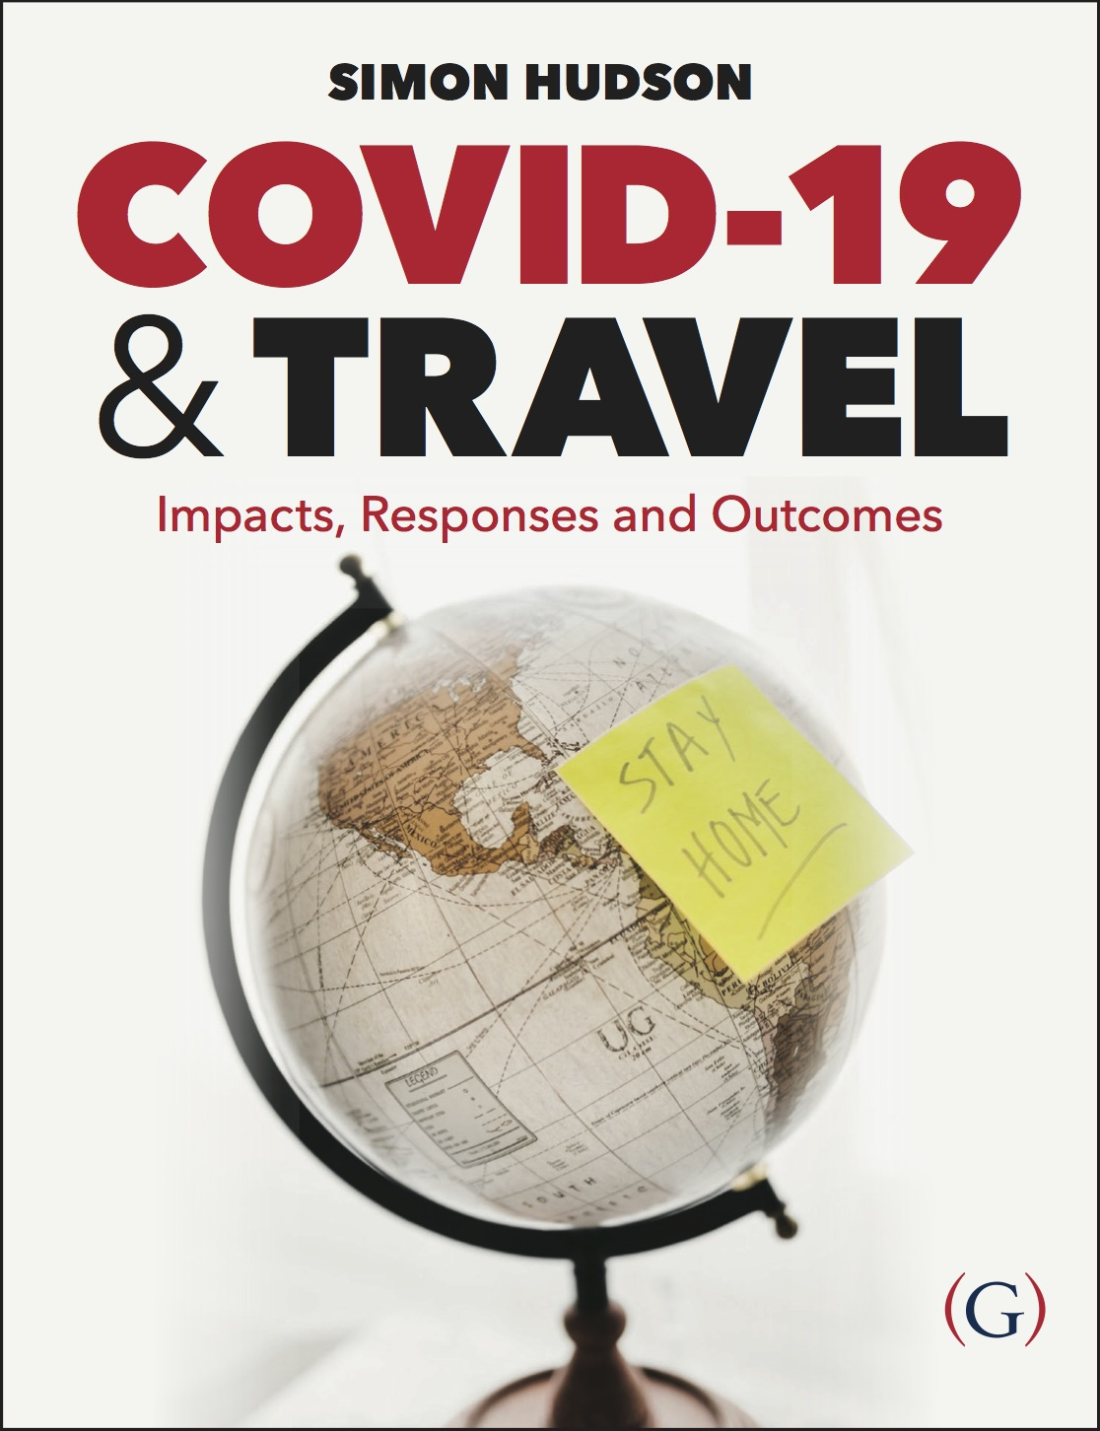
Chapter 4: How travelers were affected by the COVID-19 crisis

Slide 2
Topics Covered
Case Study: Pagodas and Pearls – a cruise to nowhere
Disruptions
The oblivious
Quarantined
Understanding future traveler behavior
A halo effect
Case Study: Showing love for Great Britain

Slide 3
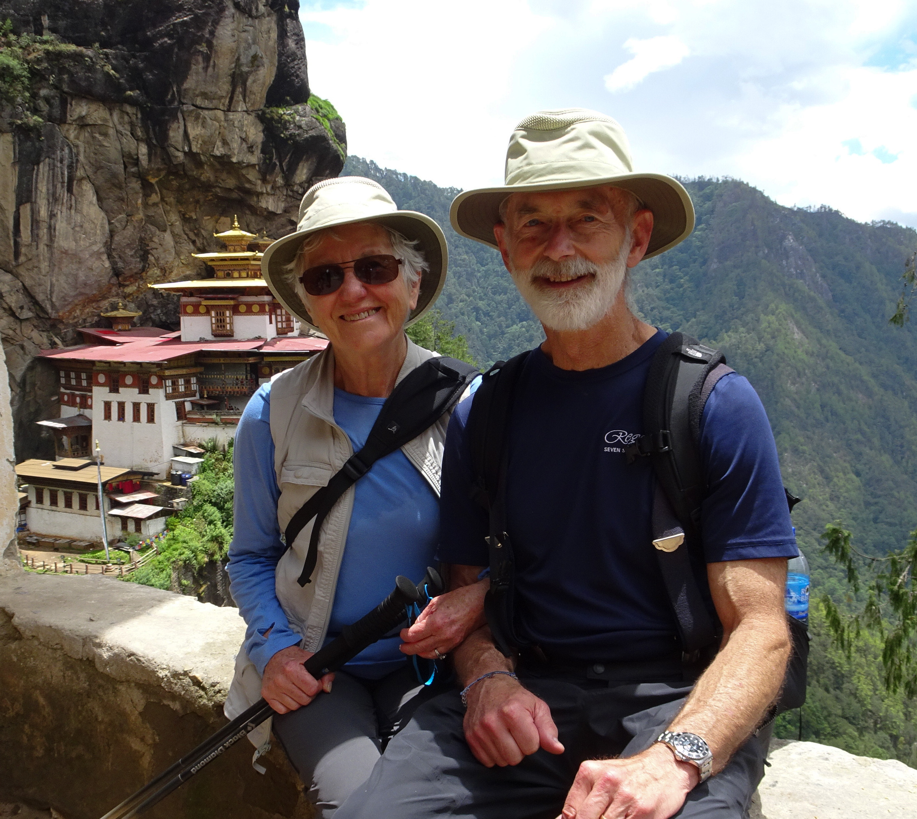
Case Study: Pagodas and Pearls – a cruise to nowhere
The Crystal Symphony cruise ship set sail from Guam on February 2, 2020
A series of port closings due to the spreading virus impacted the ship’s originally planned journey.
Twice-a-day infrared temperature screening for passengers and crew was mandated by Crystal
By booking a cruise directly through the cruise line, any hiccup in the schedule makes changing flights their responsibility
Many passengers that booked their own flights for cruise trips impacted by port closings had to spend hours and money to change flights

Slide 4
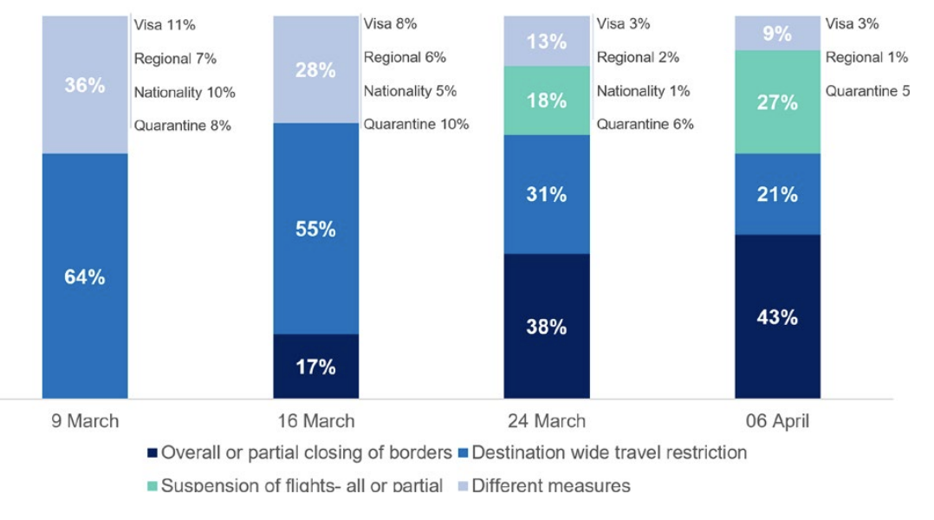
Disruptions
The number of destinations imposing travel restrictions more than doubled from 81 to 181 between March 9 and 24.

Slide 5
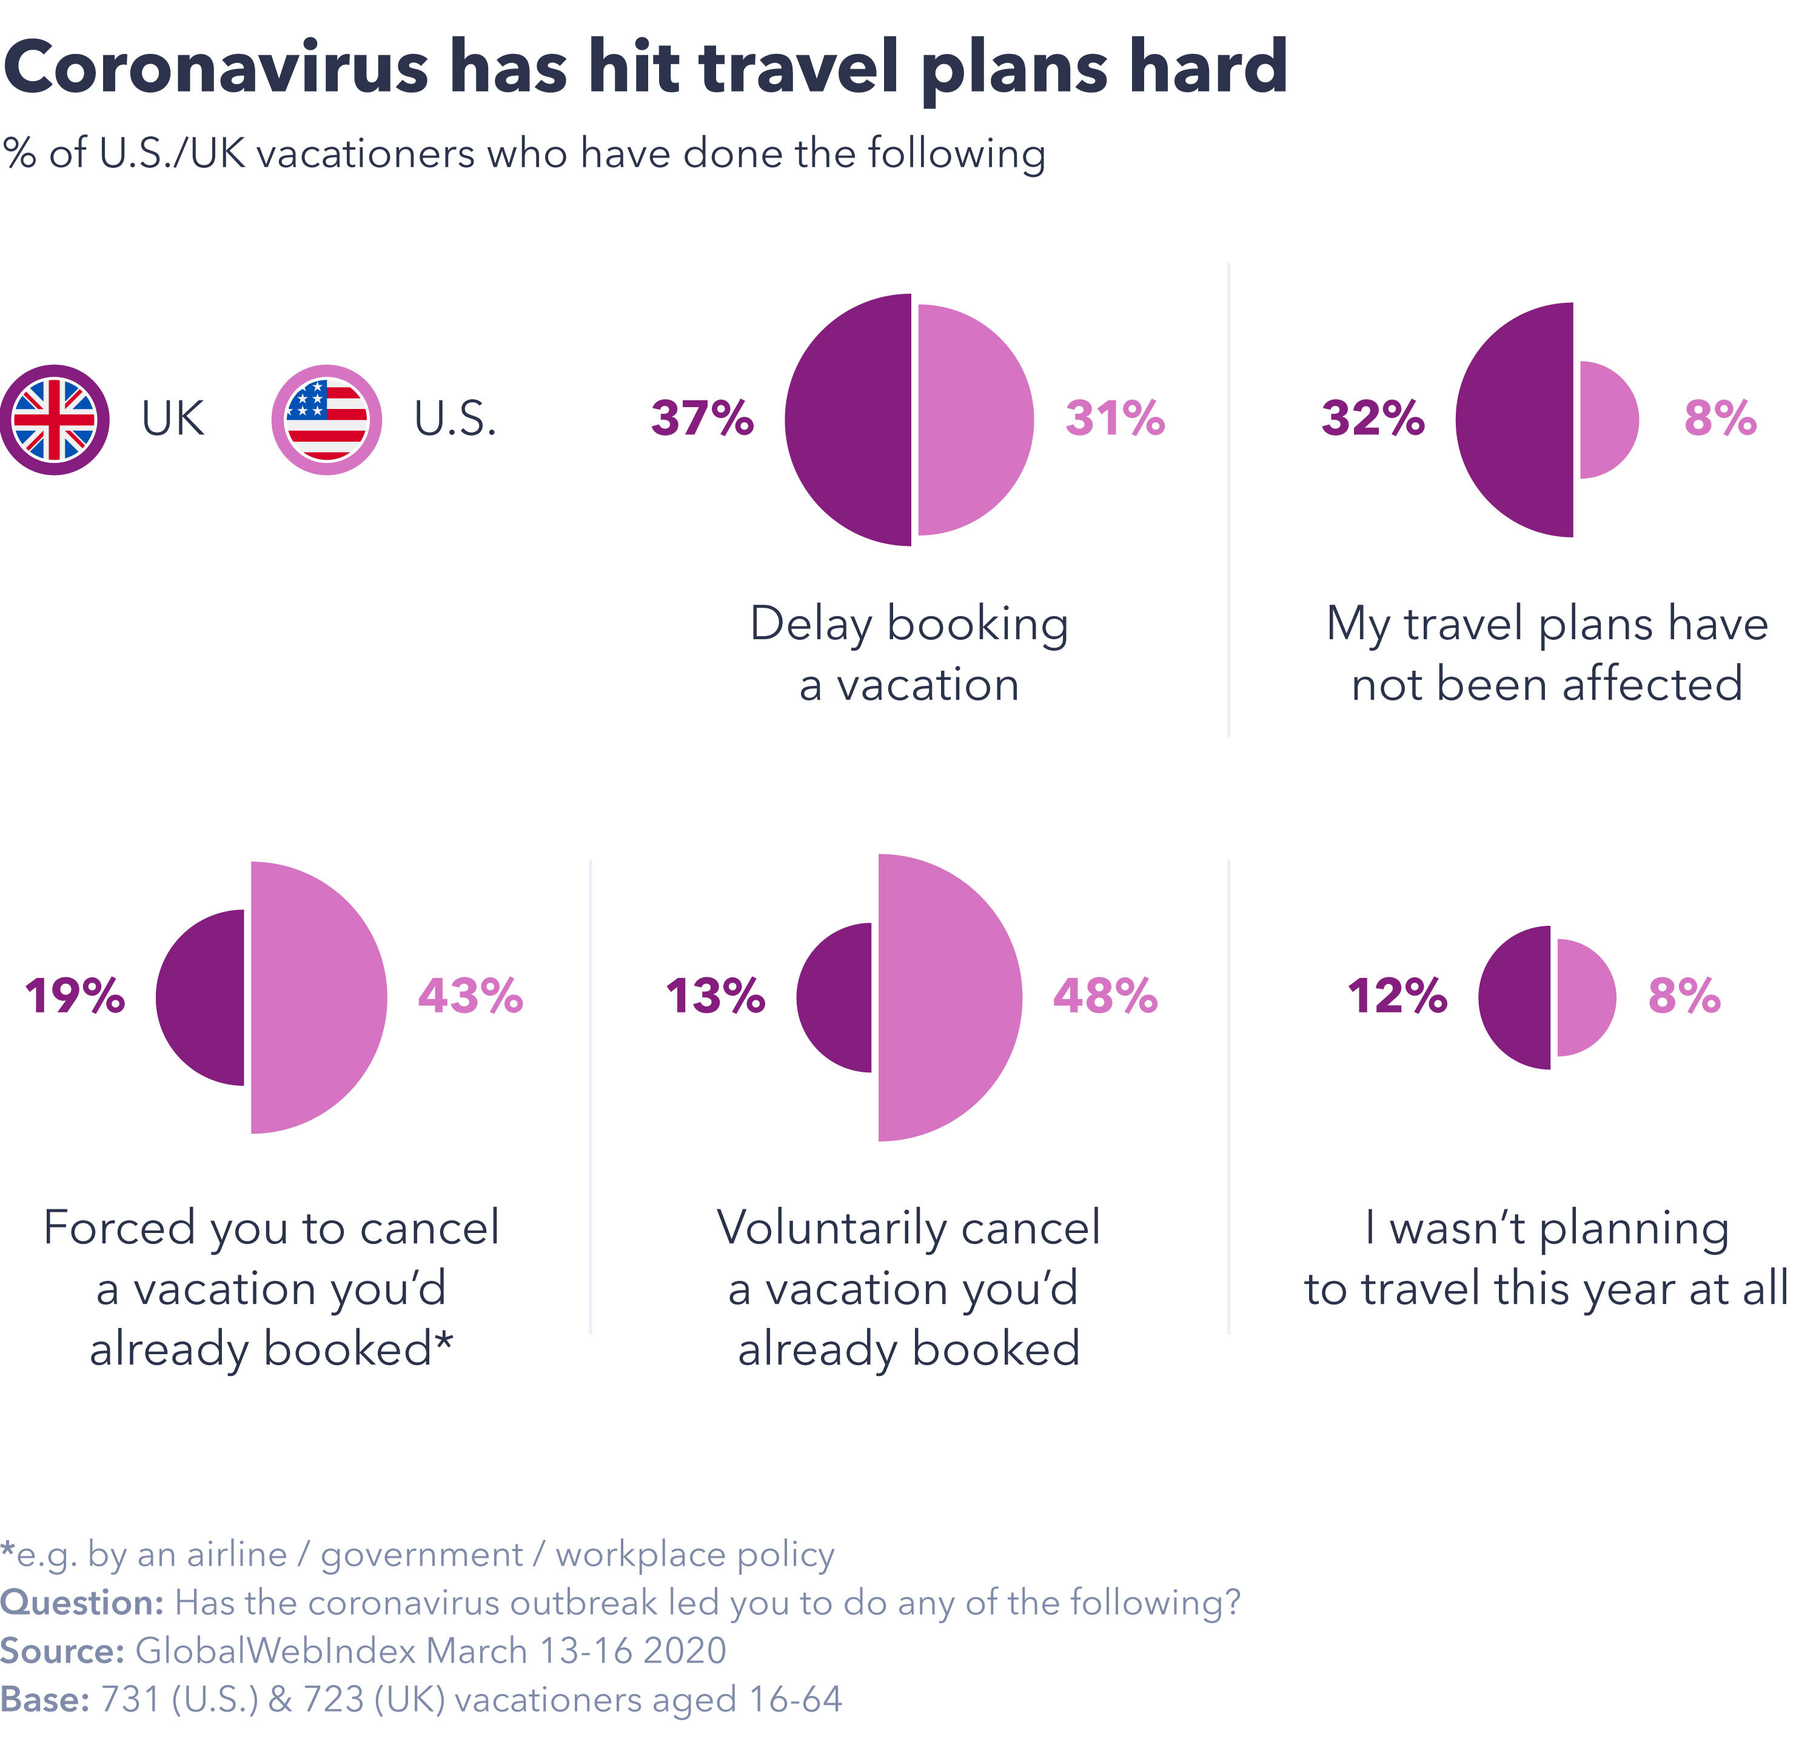
Disruptions
In March, in the UK, only 32% of vacationers hadn’t had their travel plans affected by COVID-19. In the US, this percentage was only 8%.
Businesses were challenged by mass amounts of trip cancelations and refunds owed.
Travel restrictions would prevent the spread of COVID-19 but would cause a decrease in bookings by the thousands.
The travel industry was generally well perceived by consumers to have comported itself well in reaction to cancelations.

Slide 6
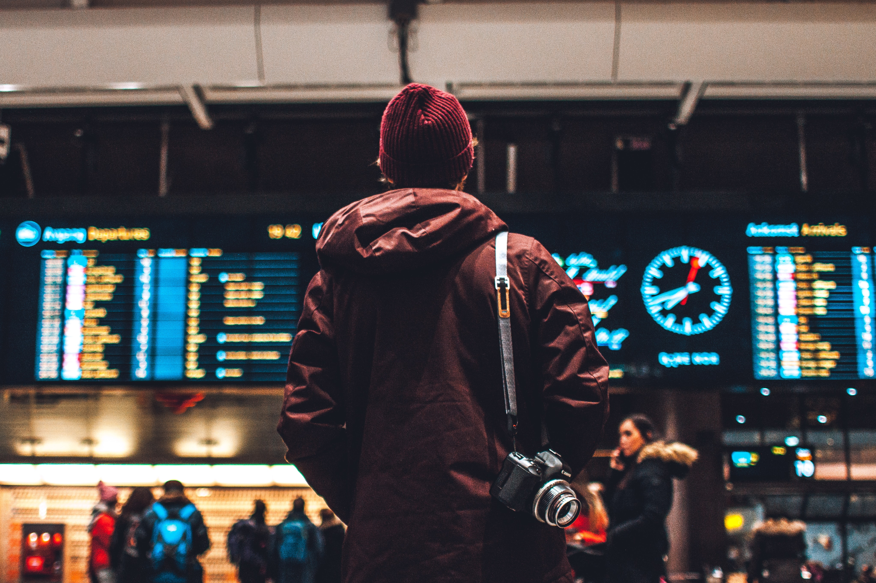
Disruptions
Customer services needed as trip cancelations spiked and customers grew concerned about refunds.
Travel insurance providers found it difficult to deliver on pledges to consumers
COVID-19 was set to cost UK travel insurers at least $335 million, most of the losses being for cancelations with some disruption costs incurred overseas.
As the pandemic continued, insurance companies were deeming the virus a ‘known event’ that customers were aware of before leaving the country.

Slide 7
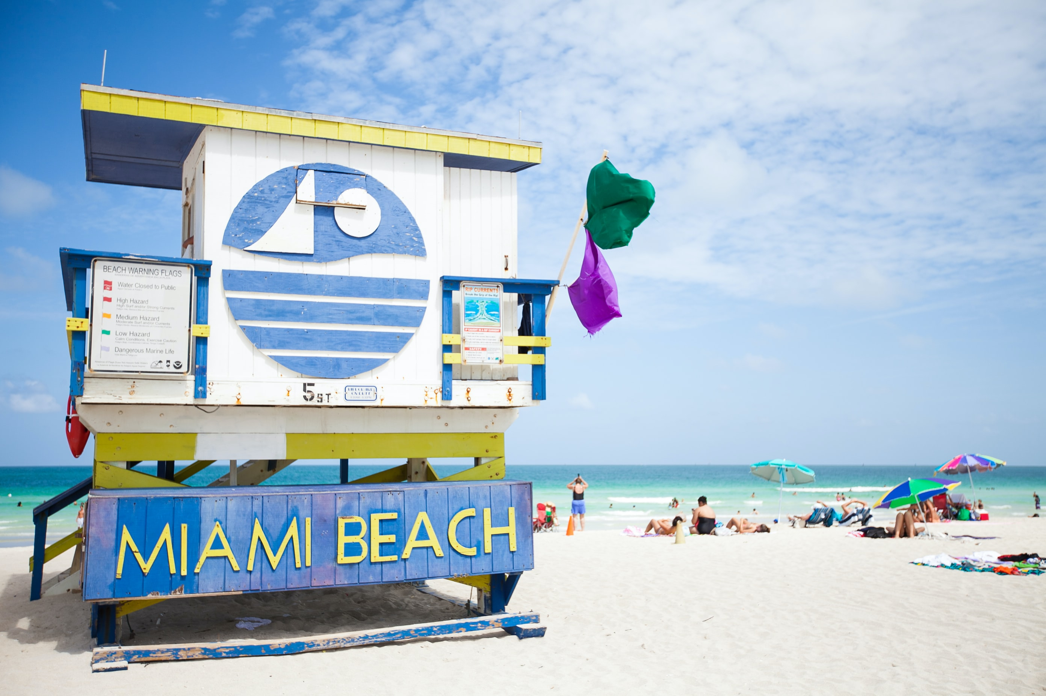
The oblivious
Some tourists were oblivious to the outbreak as a result of being off the grid on trips for extended periods of time.
Students on spring break in Florida struggled with the pandemic disrupting well-planned trips
Leaders sent mixed signals about the virus which influenced tourists and locals to behave in various ways.
Not all large-group events were canceled, and cases as far away as California and Massachusetts were linked to the Winter Party Festival in Miami Beach, FL in March.

Slide 8
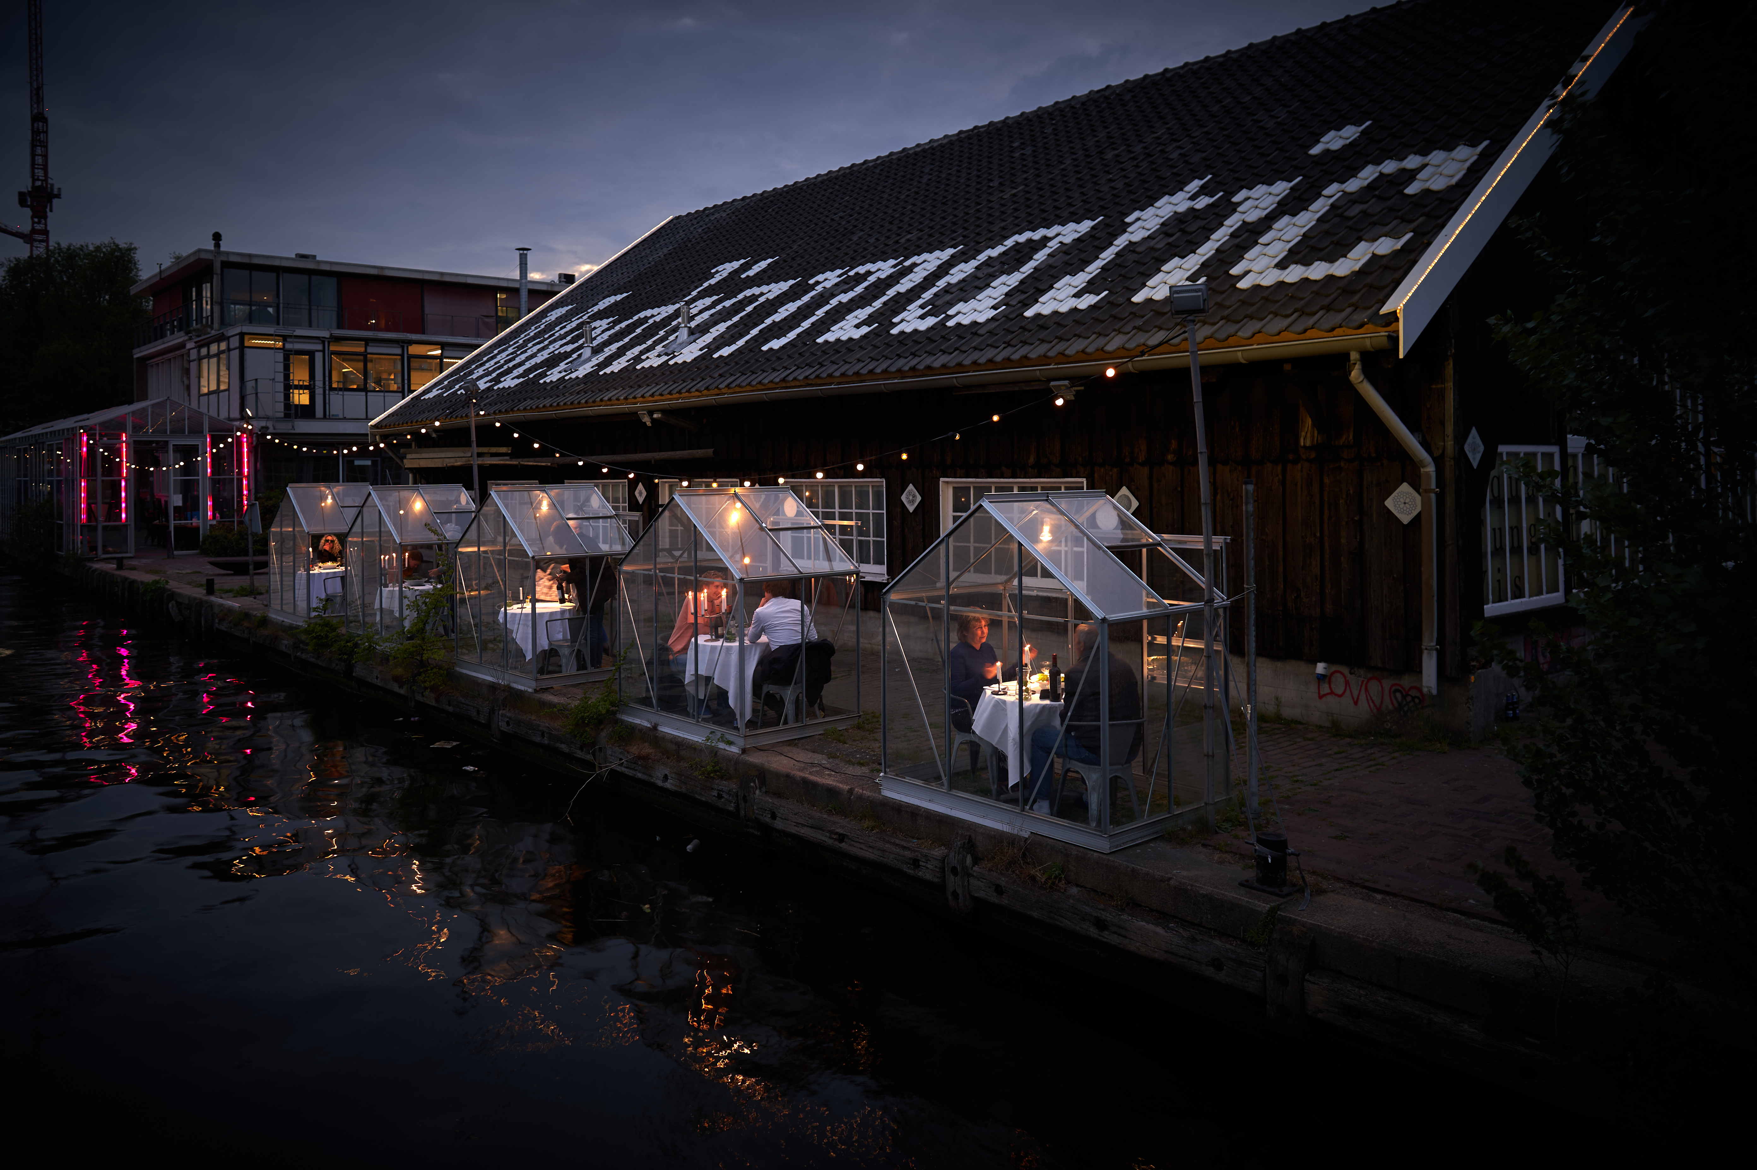
Quarantined
The word “quarantine” is derived from ‘quarantine’, the Italian word for a 40-day period.
Quarantine measures introduced for travelers during the COVID-19 pandemic were not as restrictive as those in the 14th century but were nevertheless a deterrent to travel.
Mediamatic ETEN, an Amsterdam restaurant, built small quarantine greenhouses where people could sit and enjoy dinner by the canal.

Slide 9
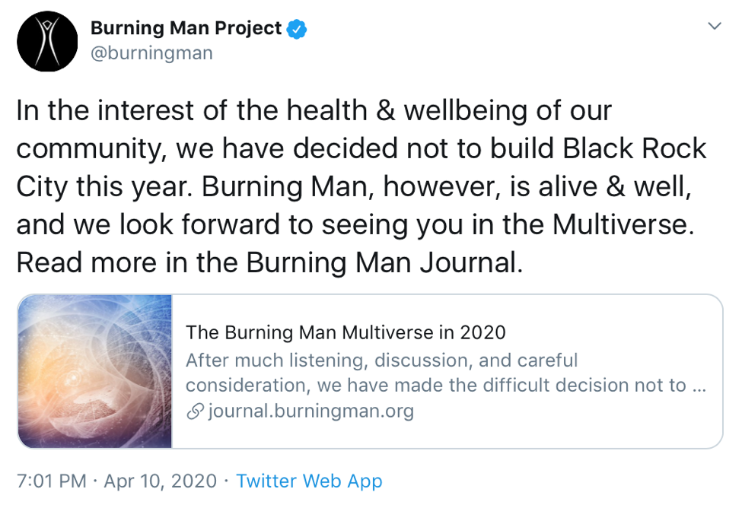
Quarantined
Some destinations and events saw the quarantine period as an opportunity to allow consumers to experience their products and experiences virtually.
Burning Man, held annually in Nevada, was a popular event to go to online, which was a re-creation of its desert culture in cyberspace.

Slide 10
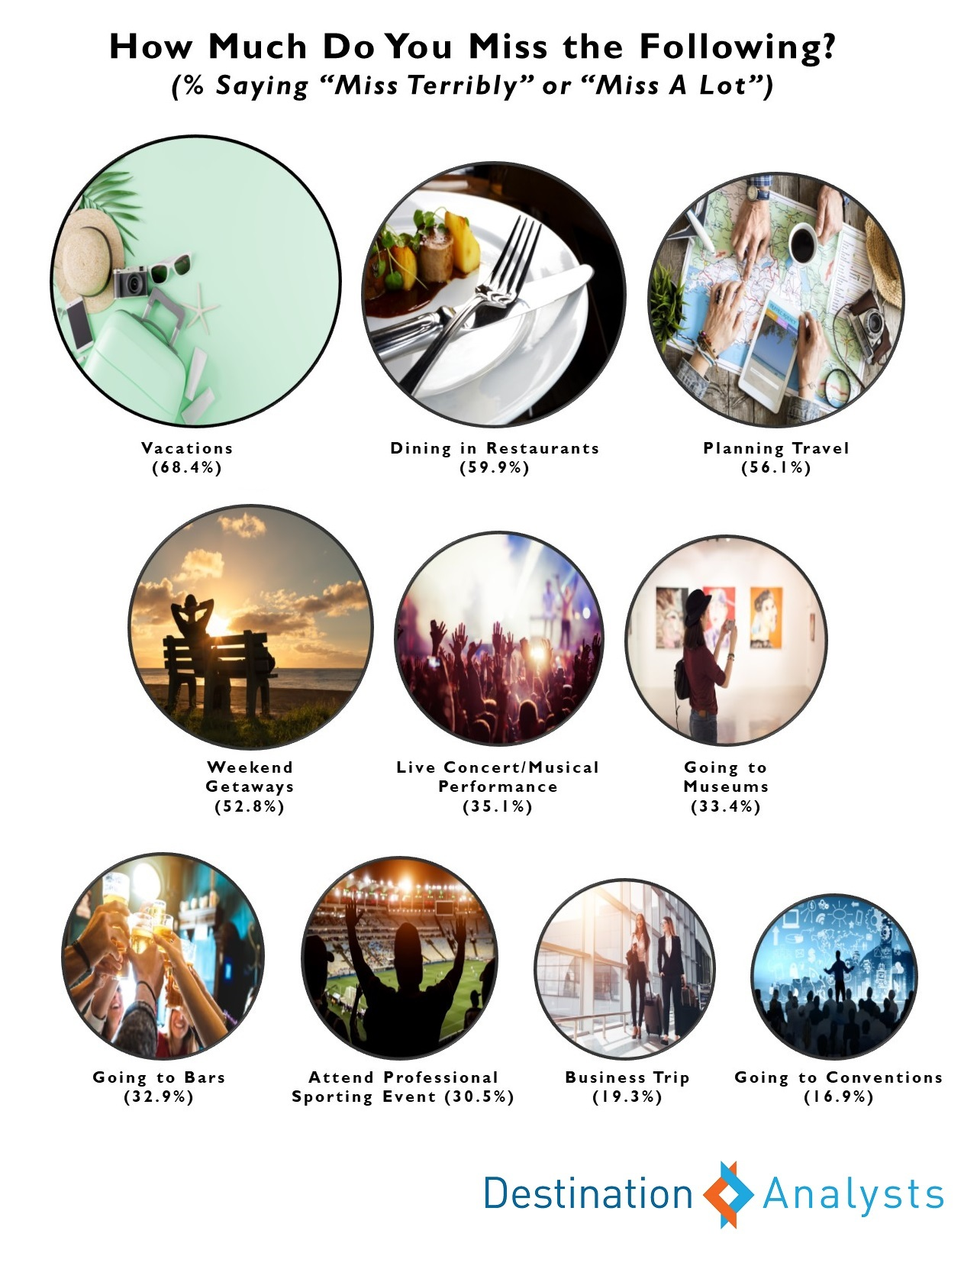
Understanding future traveler behavior
Researchers sought to understand traveler sentiment in order to gauge future traveler behavior.
Strong travel insurance policy and flight discounts were assumed to attract some travelers to book during the outbreak.

Slide 11
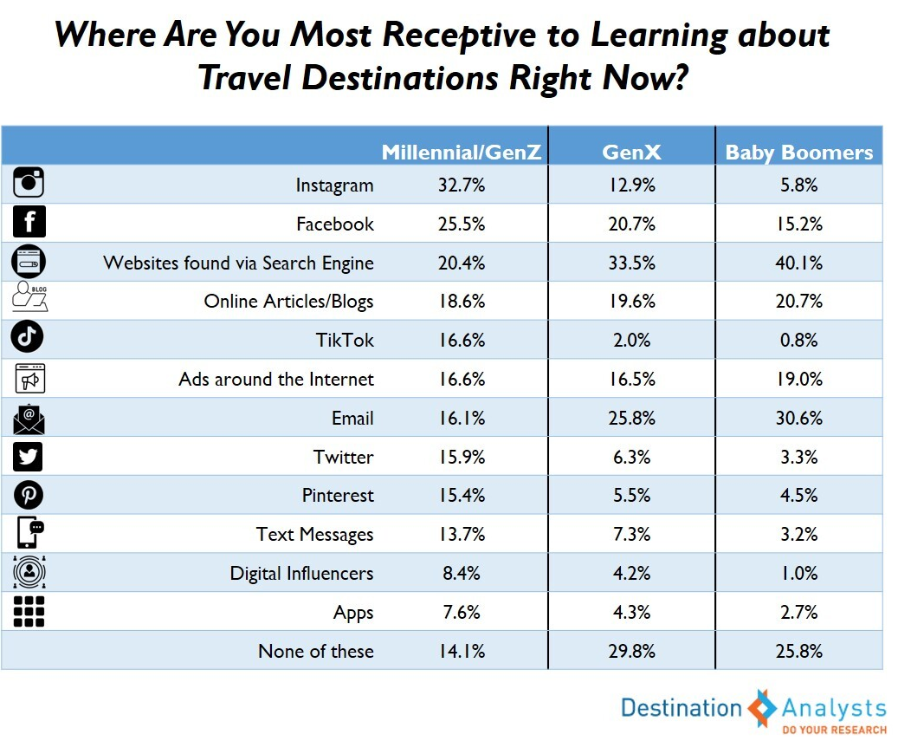
Understanding future traveler behavior
While there was a decrease in traffic to travel websites during lockdown, research suggested that over half of US consumers were missing the act of planning travel.
According to surveys of American consumers, they were most receptive to learning about travel destinations through digital resources.
Travelers find it important to be taught about destinations in an honest but friendly tone in advertising.

Slide 12
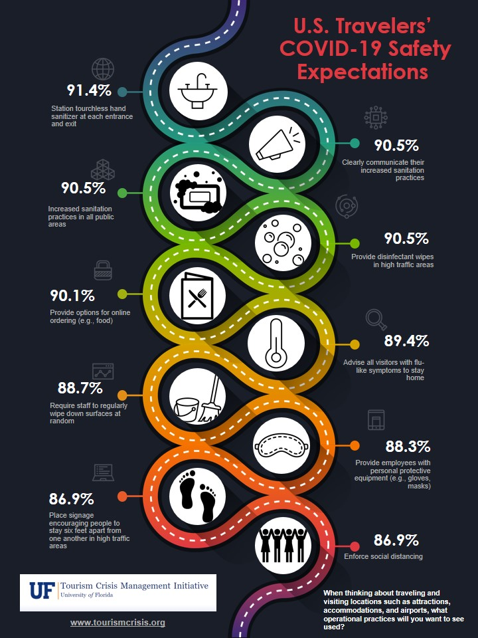
Understanding future traveler behavior
As lockdown restrictions eased in the US in May, travelers were less anxious about traveling than in previous months, but they wanted safety reassurances from travel providers.
3 in 10 travelers said they would be taking more staycations and a similar proportion said they would take more domestic than foreign vacations.
Travelers said feelings of safety would prompt them to start booking to travel again.

Slide 13
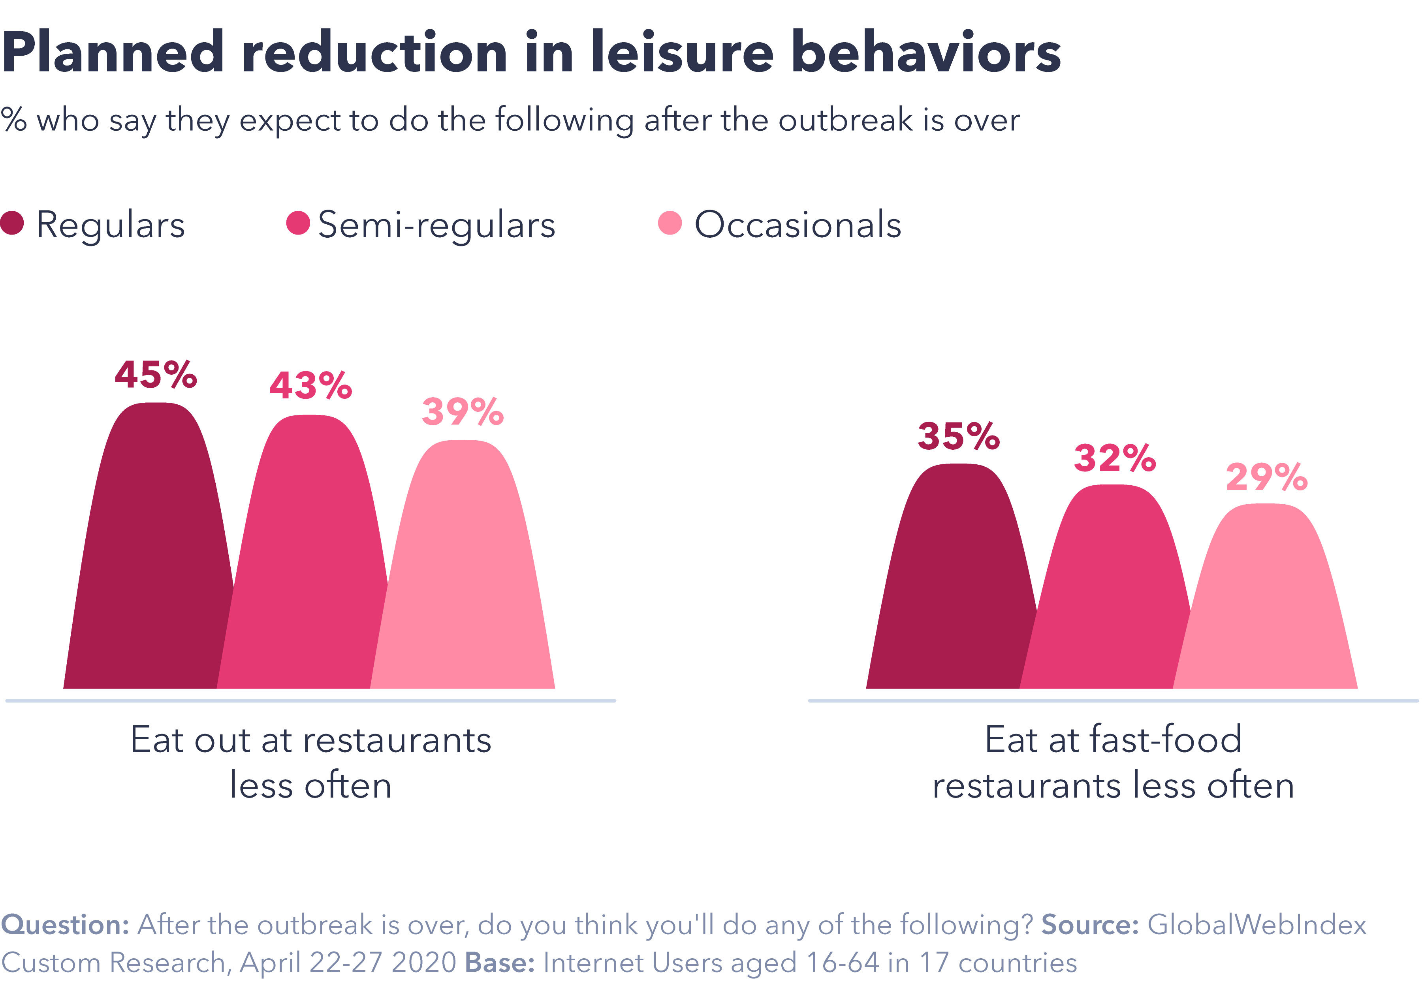
Understanding future traveler behavior
29% of consumers planned to visit bars and pubs less often
31% of consumers planned to eat at fast-food outlets less frequently.

Slide 14
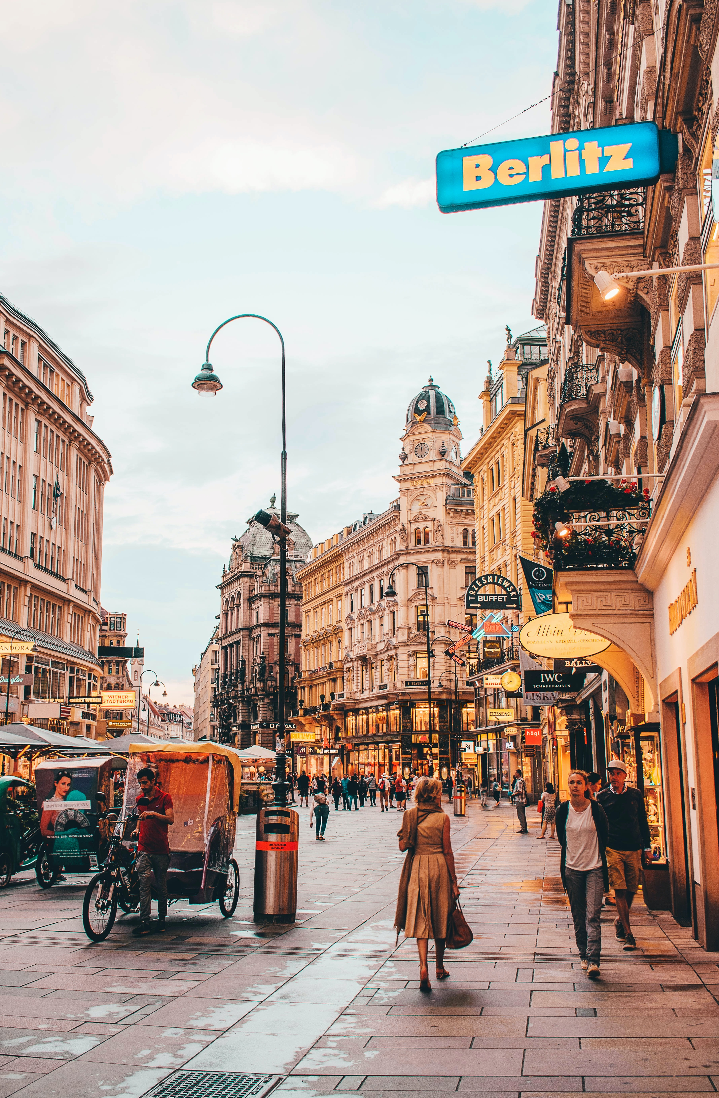
Understanding future traveler behavior
In Vienna, Austria, 950,000 households were given 50-euro vouchers to spend in local restaurants and cafes after reopening in May to help those businesses back on their feet.

Slide 15
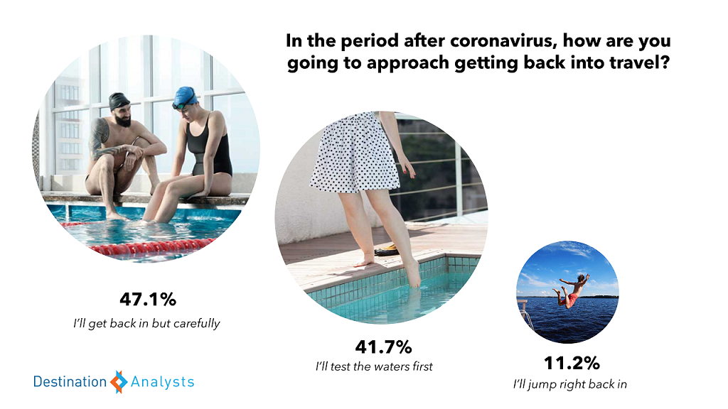
Understanding future traveler behavior
The vast majority of US travelers in early May said they would approach travel with trepidation as they thought about starting again.
Similar hesitation was apparent amongst consumers elsewhere in the world.

Slide 16
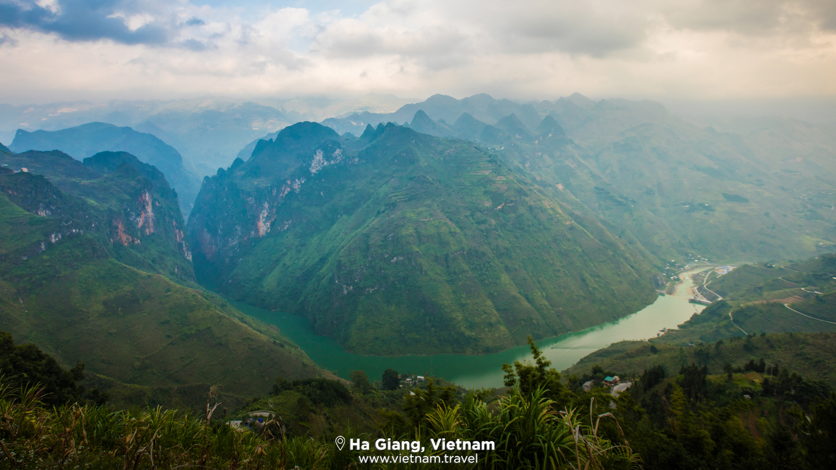
A halo effect
The perceived image of a country in general can have a significant influence on how people develop beliefs about the country as a travel destination.
As countries eased lockdown restrictions, some tourism destinations were hoping that there might be a halo effect resulting from perceptions as ’COVID-free’.

Slide 17
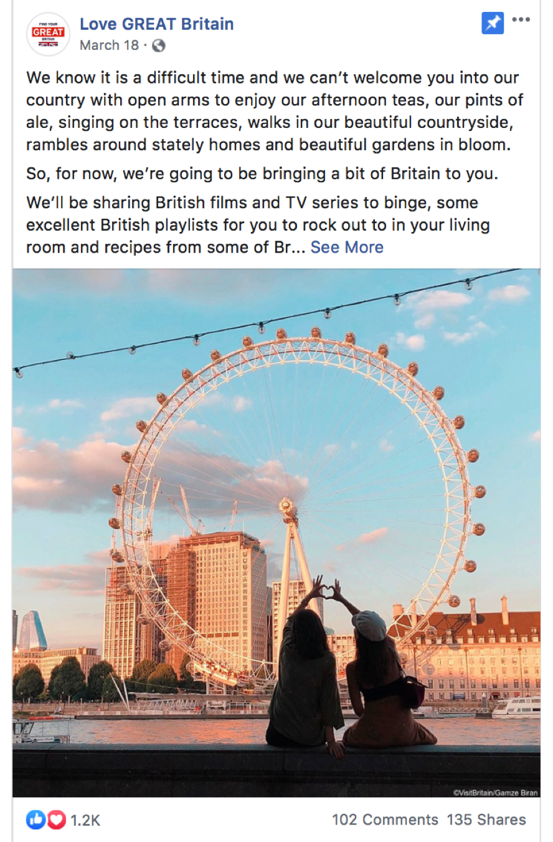
Case Study: Showing love for Great Britain
VisitBritain refocused its international marketing activity to maintain dialogue with consumers while unable to promote travel.
A campaign named Showing love for Great Britain promoted popular British culture from literature, film and music to heritage, gardens and food and drink across social channels
Followers of the campaign were invited to explore ’virtually’ the filming locations featured in Harry Potter films.
VisitBritain capitalized on the UK’s rich musical heritage by creating dedicated Spotify playlists for followers and by promoting famous music locations in the country in efforts to lure travelers there after lockdowns ease.
“Try before you buy” was encouraged as a principle for potential visitors to explore attractions ‘virtually’ first.

Slide 18
Video Links
Burning Man cancellation → https://journal.burningman.org/2020/04/news/official-announcements/brc-2020-update/
Amsterdam restaurant → https://www.youtube.com/watch?v=fj-kHU1_-os
BBC Travel show – very good – covers various topics including future of flying, travel bubbles → https://www.youtube.com/watch?v=rz6p7YynVZI
British tourists stranded in Nepal wait for repatriation flight → https://www.youtube.com/watch?v=Xafh8IHm6NE
Thousands of tourists stranded in Nepal after lockdown → https://www.youtube.com/watch?v=rsCpYx0vW0Y
Does travel insurance cover a coronavirus-related cancellation? → https://www.youtube.com/watch?v=IVZE6nDoteo
Couple returns from rafting trip and goes into quarantine → https://www.youtube.com/watch?v=03wYAeDFc0U
Off-The-Grid River Rafters Learn of Pandemic After 25 days Without Contact → https://www.youtube.com/watch?v=PegHBwGw-wE
Spring breaker express frustrations over coronavirus precautions in Miami→ https://www.youtube.com/watch?v=oa4i9Ap6dCg
Reykjavík Newscast #2: Iceland will open their border and offer tests for tourists → https://www.youtube.com/watch?v=dEtund9au7A
New Zealand and Australia in 'travel bubble' talks as no new cases reported in New Zealand → https://www.youtube.com/watch?v=PsfbV_Th1Ok
Why Florida should have shut down spring break amid coronavirus outbreak → https://www.youtube.com/watch?v=PGPR6dEHF7E

